Slide 1
SHADOWFOX | MACHINE LEARNING ENGINEER INTERNSHIP
Car Selling Price Prediction
Regression models for used-vehicle prices: from exploratory analysis to a saved Gradient Boosting model
Samarth Jain
Sage University, Indore
Intermediate Level • SF-PID-2026-W7613 • November 2026
Notes:
Introduce yourself and the project. This is my Intermediate-level project for the ShadowFox Machine Learning Engineer internship: predicting the selling price of used vehicles with regression models.

Slide 2
Project Overview
299
7
7
records after removing 2 duplicates
input features (incl. engineered Car_Age)
models compared (5 baseline + 2 tuned)
Goal: predict the selling price of a used vehicle from its characteristics (supervised regression).
Workflow: cleaning, EDA, feature engineering, five baseline models, tuning of Random Forest and Gradient Boosting.
Best model: baseline Gradient Boosting with R² 0.7530 on the held-out test set.
Notes:
The dataset has 301 rows; two exact duplicates were removed, leaving 299. Seven features go into the models. I compared five baseline algorithms and then tuned two of them, so seven models in total. The baseline Gradient Boosting model came out best.

Slide 3
Problem Statement
Given what we know about a used vehicle, what price will it sell for?
INPUTS (7 features)
TARGET
Present_Price
Kms_Driven
Owner
Car_Age
Fuel_Type
Seller_Type
Transmission
Selling_Price
A continuous value, so this is a regression task
Notes:
The inputs are the current ex-showroom price, kilometres driven, number of previous owners, the age of the vehicle, fuel type, seller type and transmission. The target, Selling_Price, is continuous, so the task is regression.

Slide 4
Project Objectives
Analyse the dataset and its features
Clean and preprocess the data
1
2
Perform Exploratory Data Analysis
Engineer and select features
3
4
Train and compare regression models
Tune with RandomizedSearchCV
5
6
Evaluate with MAE, MSE, RMSE, R²
Identify the most influential features
7
8
Notes:
Eight objectives, covering the full workflow from data understanding to identifying which features drive the price.

Slide 5
Dataset
Column | Description
Car_Name | Name of the vehicle
Year | Year of manufacture (2003–2018)
Selling_Price | Target variable
Present_Price | Current ex-showroom price
Kms_Driven | Distance driven (500–500,000 km)
Fuel_Type | Petrol, Diesel or CNG
Seller_Type | Dealer or Individual
Transmission | Manual or Automatic
Owner | Number of previous owners
301 → 299
rows (2 duplicates removed)
0
missing values
Note: the file mixes 198 cars and 101 two-wheelers (identified from Car_Name); the notebook does not separate them.
Notes:
Nine columns, 301 rows, no missing values. Two exact duplicates were removed. While verifying the data I noticed that Car_Name includes two-wheelers such as Royal Enfield, Bajaj and Honda Activa models: about 101 of 299 records. The notebook treats everything together, so I list this as a limitation. The currency unit of the price columns is not documented in the file.

Slide 6
Technology Stack
1
2
3
Python
Pandas & NumPy
Matplotlib & Seaborn
Core language
Data handling and computation
All EDA and result plots
4
5
6
Scikit-learn
Joblib
Jupyter Notebook
Pipelines, models, tuning, metrics
Saving the final model
Development environment
Notes:
The whole project is in Python inside a Jupyter notebook. Scikit-learn provides the preprocessing pipeline, the models, RandomizedSearchCV and metrics. Joblib saves the final model.

Slide 7
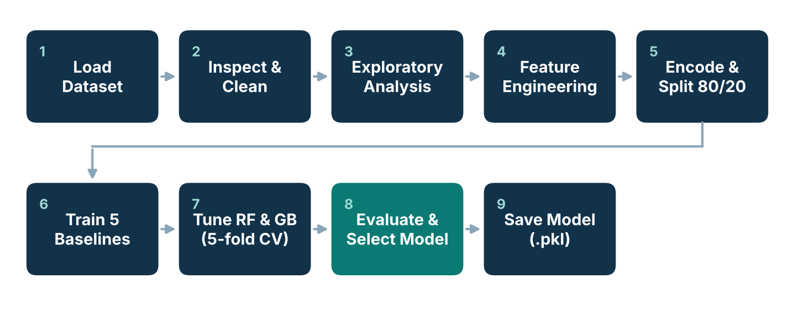
Methodology and Implementation Workflow
Each step maps to a section of the notebook. Preprocessing is fitted on training data only.
Notes:
Nine steps: load, inspect and clean, EDA, feature engineering, encoding and the 80/20 split, five baseline models, tuning of Random Forest and Gradient Boosting, evaluation and selection, and saving the model. Encoding is fitted on the training data only to avoid leakage.

Slide 8
Data Preprocessing
1
Clean
Removed 2 exact duplicates; no missing values found
2
Engineer
Car_Age = 2018 − Year
3
Select
Dropped Car_Name (98 unique values) and Year; kept 7 features
4
Encode
One-hot encoding of Fuel_Type, Seller_Type, Transmission → 11 columns
5
Split
80% train (239) / 20% test (60), random_state = 42
Outliers (e.g. Present_Price 92.6, Kms_Driven 500,000) were kept; no feature scaling was applied.
Notes:
Car_Age replaces Year so the model sees age directly. Car_Name has 98 unique values for only 299 rows, so it was excluded. The three categorical features were one-hot encoded inside a ColumnTransformer, giving 11 model-ready columns. Train and test sets have 239 and 60 records.

Slide 9
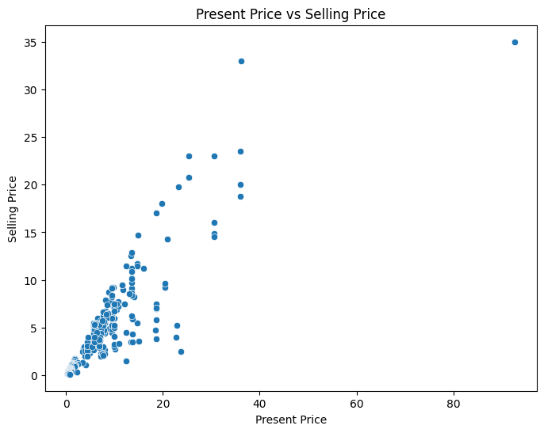
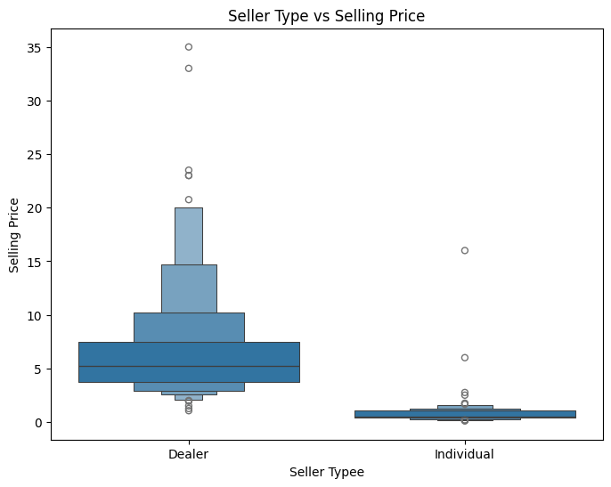
EDA: Key Relationships with Selling Price
Present_Price rises almost linearly with Selling_Price (r = 0.88).
Dealer listings sell higher than individual listings (medians 5.25 vs 0.52); the vehicle mix influences this.
Notes:
Left: current price against selling price shows a strong, nearly linear relationship. Right: dealer listings have much higher selling prices than individual listings. Part of that gap reflects the mix of cars and cheaper two-wheelers in the file, so it should not be read as a pure seller effect.

Slide 10
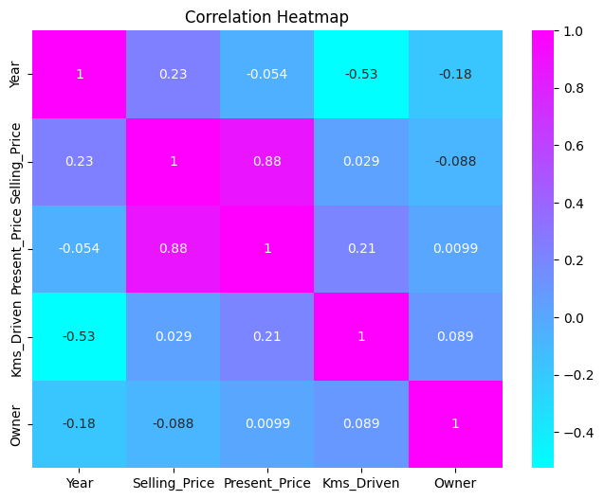
EDA: Correlation Analysis
0.88
0.23
Present_Price
Year
−0.088
0.029
Owner
Kms_Driven
Correlation with Selling_Price. Present_Price dominates; mileage shows almost no linear link, likely masked by one 500,000 km outlier and the vehicle mix.
Notes:
The heatmap shows Present_Price with r = 0.88, Year 0.23, Owner −0.088 and Kms_Driven only 0.029. Note: the notebook text calls the Kms_Driven relationship negative, but the heatmap value is slightly positive and essentially zero, so I follow the plotted numbers.

Slide 11
Model Development
Baseline models (default settings)
Hyperparameter tuning
Linear Regression
Decision Tree Regressor
Random Forest Regressor
Gradient Boosting Regressor
Support Vector Regressor (no scaling)
RandomizedSearchCV on Random Forest and Gradient Boosting
50 sampled combinations each
5-fold cross-validation (250 fits per model)
Scoring: negative RMSE
Preprocessor inside a Pipeline
Metrics: MAE, MSE, RMSE, R²
Notes:
Five baseline models were trained with default settings and random_state 42 where applicable. SVR was run without feature scaling. Random Forest and Gradient Boosting were then tuned with 50 random combinations and 5-fold cross-validation. Best tuned Gradient Boosting: 300 estimators, depth 4, learning rate 0.1, subsample 0.8. Best tuned Random Forest: 100 estimators, depth 20.

Slide 12
Evaluation: R² Score by Model
BEST MODEL
Gradient Boosting (baseline)
R²
0.7530
RMSE
2.5232
MAE
1.1349
MSE
6.3667
Notes:
Test-set R² for all seven models. Baseline Gradient Boosting is best at 0.7530 with RMSE 2.5232 and MAE 1.1349. Linear Regression is practically tied on R² and RMSE (0.7528 and 2.5240), but Gradient Boosting has a clearly lower MAE. SVR is worst with a negative R², which means it did worse than predicting the mean; it was trained without feature scaling.

Slide 13
Evaluation: Full Comparison (Test Set)
Model | MAE | MSE | RMSE | R²
Gradient Boosting (Baseline) | 1.1349 | 6.3667 | 2.5232 | 0.7530
Linear Regression | 1.4729 | 6.3708 | 2.5240 | 0.7528
Decision Tree | 1.3273 | 8.4855 | 2.9130 | 0.6708
Gradient Boosting (Tuned) | 1.3016 | 9.4343 | 3.0715 | 0.6339
Random Forest (Tuned) | 1.3851 | 10.6659 | 3.2659 | 0.5862
Random Forest (Baseline) | 1.5270 | 13.7505 | 3.7082 | 0.4665
SVR (Baseline) | 3.1295 | 28.3205 | 5.3217 | −0.0988
Tuning helped Random Forest (R² 0.4665 → 0.5862) but not Gradient Boosting (0.7530 → 0.6339). With only 60 test records, Gradient Boosting and Linear Regression should be seen as similar on R² and RMSE.
Notes:
All values come straight from the notebook and were independently reproduced. Tuned models did not beat the baseline Gradient Boosting on this particular test split. Cross-validation RMSE for the tuned models was lower (1.54 for Random Forest, 1.38 for Gradient Boosting) than their test RMSE, which is not unusual for a small dataset.

Slide 14
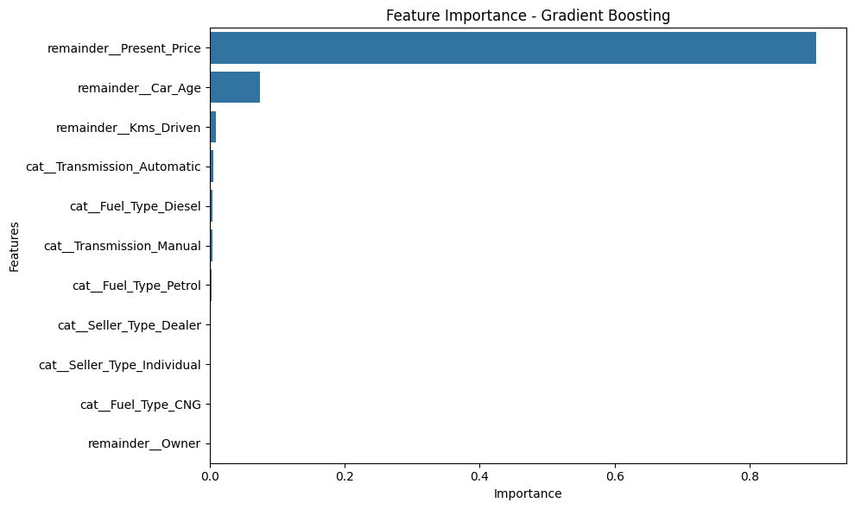
Feature Importance (Gradient Boosting)
89.85%
Present_Price
7.49%
Car_Age
0.97%
Kms_Driven
Notes:
Present_Price carries almost 90 percent of the importance, then Car_Age at about 7.5 percent and Kms_Driven at about 1 percent. This matches the EDA: current price signals resale value and age captures depreciation.

Slide 15
Challenges and Solutions
High-cardinality Car_Name
Excluded from inputs
Year is not a direct age measure
Engineered Car_Age = 2018 − Year
Categorical features
One-hot encoding fitted on training data only
Leakage risk during tuning
Preprocessor inside a Pipeline, evaluated per fold
Tuned models below baseline on test split
Reported honestly; kept baseline Gradient Boosting
Notes:
Each challenge and how it was handled in the notebook. The last one is important: I did not hide that tuning failed to improve Gradient Boosting on the test split.

Slide 16
Limitations and Future Scope
Limitations
Future scope
Small dataset (299 records)
Test set used while comparing models, so results are exploratory
SVR trained without feature scaling
Cars and two-wheelers mixed together
Price currency unit not documented
Select models with cross-validation; keep test set for the final check
Scale features and re-evaluate SVR
Model cars and two-wheelers separately
Try a log-transformed target
Larger, more recent dataset and a simple prediction app
Notes:
Be upfront about limitations. The most important are the small sample, using the test set for model selection, and the cars/two-wheelers mix. Future work addresses each of these.

Slide 17
Conclusion
0.7530
2.5232
1.1349
R² (best model)
RMSE
MAE
Baseline Gradient Boosting was the best of seven models on the held-out test set.
Present_Price (about 90%) and Car_Age (about 7.5%) drive the predictions.
The final preprocessor and model are saved in best_car_price_model.pkl and reproduce the reported results.
A solid exploratory baseline; larger data and cleaner model selection are the next steps.
Notes:
Wrap up: the best model, what drives price, and that the saved model reproduces the reported metrics. Thank the mentor and invite questions.

